Slide 1
Youth Criminal Justice Act
Early History

Slide 2
In the 1600s, age 7 was determined as the minimum age for criminal responsibility
In 1892 Canada’s Criminal Code outlined that children be tried separately from adults and without publicity.
1908, Parliament passed the Juvenile Delinquents Act and created a separate juvenile court to handle the specific needs of the child

Slide 3
Youth Criminal Justice Act was passed in 2002 and proclaimed law in April 2003.
3 Objectives:
Prevent crime
Rehabilitate
Reintegrate

Slide 4
Philosophy
Young offenders should be treated differently from adults who are supposed to know the difference between right and wrong

Slide 5
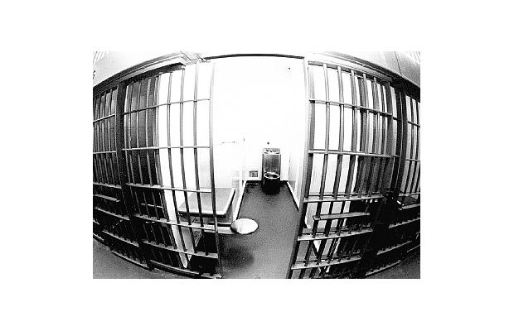
Interesting Statistic BUT...
75% of all youth crime is non-violent
Most crimes youths are charged with are property related offences like theft and mischief.

Slide 6
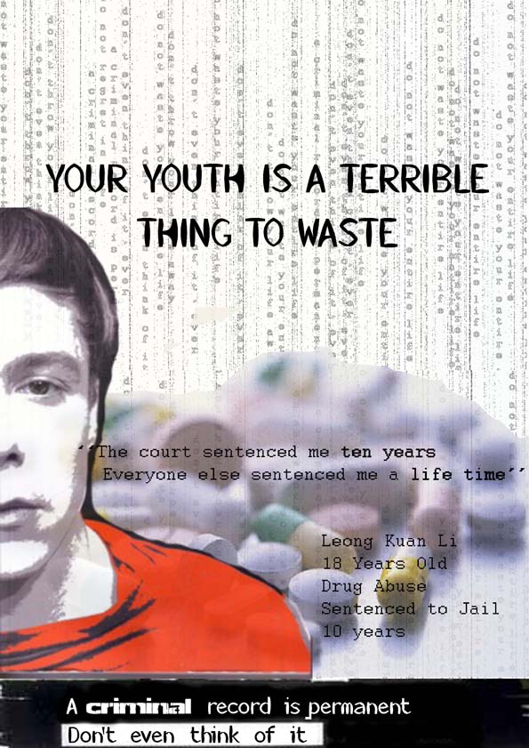
What are the possible reasons youths commit crime?
Many young people have a history of :
Having their right violated
Poverty issues
Family difficulties
Child abuse
Neglect
“The court sentenced
me to ten years. Everyone else sentenced me
a life time.” Consider this statement, what do you
think it means.

Slide 7
Fetal Alcohol Spectrum
1 in 6 young offenders have
Fetal Alcohol Spectrum
Fetal Alcohol Spectrum Disorder (FASD) is a term that describes a range of disabilities that may affect people whose mothers drank alcohol while they were pregnant.

Slide 8
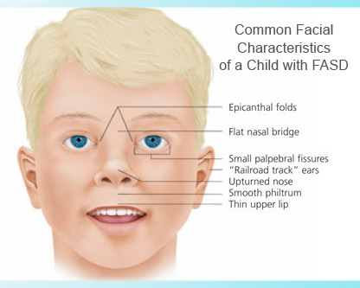
Characteristics of FASD
Anyone may have FASD if their biological mother drank alcohol
during pregnancy and they may have problems with learning,
remembering things, attention span, communicating, doing math
and/or controlling their behaviour.

Slide 9
Questions?????
Questions For Debate on YCJA
1. Why do you think harsher sentences hold young offenders more accountable for their actions?
2. To what extent should circumstances of youth be taken into account when a crime is committed? (i.e. family background, poverty,)
3. Why do you think it is necessary to treat young offenders differently than adults?
4. Can you explain why the identity of young offenders needs to be protected?
5. What do you see as the major weakness of YCJA?

Slide 10
Questions???
6. What do you see as the major strength of the YCJA?
7. The YCJA seeks to have the offending youth engage in some form of contact with the victim of the crime. Why do you think this is a good strategy?
8. How will applying harsher sentences allow for rehabilitation and reintegration into society?

