Slide 1
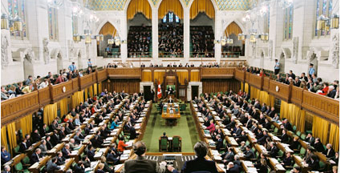
The House of Commons:
Senators and Members of Parliament.
Ms. MacWilliams, Crystal Park, 2008

Slide 2
What is a Senator?
Selection Process and Qualifications
Senators are not elected. The are appointed by the Governor General on the advice of the Prime Minister.
Senators must be at least 30 years old and retire by the age of 75.
Senators also must live and own property in the Canadian province or territory that they represent.
Backgrounds of Senators include former provincial premiers, cabinet ministers and business people from many economic sectors. This wide range of experience provides an expertise that helps with their investigations.

Slide 3
What is a Senator?
Roles and Responsibilities
Examine and revise the legislation
provide a “sober, second thought”
review federal legislation clause by clause
have the power to introduce bills
Investigate national Canadian issues
contribute to in-depth studies on public issues
Represent regional, provincial and minority interests
meet and consider regional impact of legislation
represent the rights of groups/individuals who may be overlooked

Slide 4
What is a Senator?
Roles and Responsibilities
Watchdog on government
provide a detailed review of all legislation
routinely question and challenge the Leader of the Government
Party Supporters
supports a political party and plays a role in it’s operation

Slide 5
What is a Member of Parliament?
Selection Process and Qualifications
MP’s are elected in a general election

Slide 6
What is a Member of Parliament?
Roles and Responsibilities
Representing constituents in Parliament
the ‘people’s’ representatives in the House of Commons
maintain a high profile
Making Laws
influence legislation through debates
Watchdogs on Government
influence federal government policy
raise policy issues and concerns

Slide 7
What is a Member of Parliament?
Roles and Responsibilities
Party Supporters
usually belong to a political party and plays a role in it’s operation
Offices
maintain two offices with staff for which they are responsibe (Parliament Hill and in their constituency)

