Slide 1
Why Come to Canada?
Why is Canada appealing?
What does someone have to do to be allowed into Canada?
Can just anyone become a Canadian Citizen?

Slide 2
Becoming Canadian
Becoming Canadian is not an easy process, there are many variables involved
Watch these videos to get a background about Canada’s immigration process
http://www.cic.gc.ca/english/department/media/multimedia/video/becoming_canadian/citizenship/citizenship.asp
http://www.cic.gc.ca/english/department/media/multimedia/video/becoming_canadian/integration/integration.asp
http://www.cic.gc.ca/english/department/media/multimedia/video/becoming_canadian/refugee/refugee.asp
http://www.cic.gc.ca/english/department/media/multimedia/video/becoming_canadian/students/students.asp
http://www.cic.gc.ca/english/department/media/multimedia/video/speech/2009-03-18.asp
http://www.cic.gc.ca/english/department/media/multimedia/video/making_a_difference/making.asp

Slide 3
Case Studies
After each video answer the questions for each of the immigrated Canadians in your handout.
http://www.cic.gc.ca/english/department/media/multimedia/video/home_native_land/chae/chae.asp
http://www.cic.gc.ca/english/department/media/multimedia/video/home_native_land/Goncalves/Goncalves.asp
http://www.cic.gc.ca/english/department/media/multimedia/video/home_native_land/Lam/Lam.asp
http://www.cic.gc.ca/english/department/media/multimedia/video/home_native_land/Noorani/Noorani.asp

Slide 4
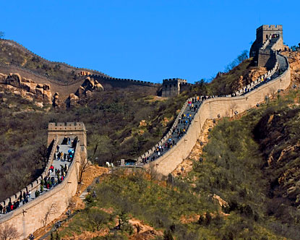
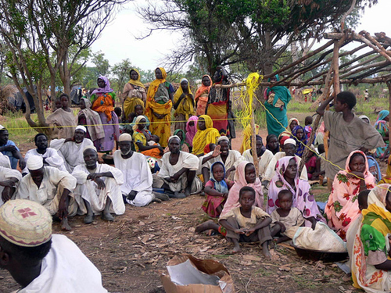
Read Page 162 in your text and answer the following question?
http://www.youtube.com/watch?v=usz3HO_xnQo&feature=related
If I lived in these countries, what reasons would I have for immigrating to Canada?
-France -China -Darfur

Slide 5
What you came up with for:
France:
China:
Darfur:

Slide 6
Canadian Immigration Application
http://www.cic.gc.ca/english/immigrate/skilled/assess/index.asp

Slide 7
The Great Immigration Story:
1. http://www.youtube.com/watch?v=Yo4ViKqT7Cw
2. http://www.youtube.com/watch?v=YausHoTooPQ&NR=1
3. http://www.youtube.com/watch?v=PJx3FZriQxI&feature=related

