Slide 1
Bias
Bias Detection in the Media

Slide 2
Be aware...
How do you know whether the news you read, watch, and hear is accurate, and if it reflects a balance of views, opinions, and perspectives?

Slide 3
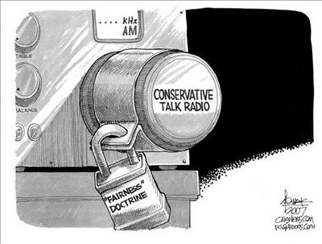

Slide 4
Consider the following to detect biases:
Who is the writer or speaker?
Do they have authority?
Does the information provide facts & evidence?
Does it use stereotyping, or appeal to fear or emotion?
Does it ignore any people or groups?
How does the information fit with what you already know?

Slide 5
What do lobbyists do?
Text pg. 51

Slide 6
Lobbyist
Someone hired by a group to influence MPs and government officials.
Must be registered with a Commissioner of Lobbyists (so everyone in Canada can know who they are and who they represent).
Voice the views of groups on issues that affect their members, products, or services.
Provide different perspectives and in-depth expertise on many issues.

