Slide 1
“Why do we have taxes?”
The Connection Between Taxation and Social Programs

Slide 2
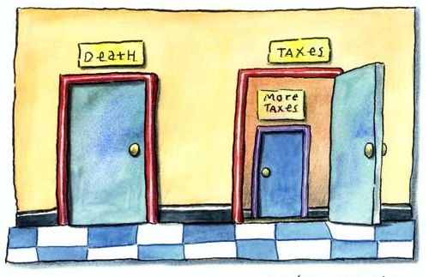
“Certainty? In this world nothing is certain but death and taxes.” – Benjamin Franklin

Slide 3
Why do we have taxes?
To pay for the government!
To help the government pay for the services it provides to its’ citizens, such as:
health care
roads & highways
Employment Insurance
Environmental Controls
Canada Pension Plan
Old Age Security
Education (universities, colleges, K-12 education)
Crown Corporations (Canada Post, National Film Board, etc)
Universal Child Care Benefit
Immigration Services
Military
RCMP
National Security (border patrols, passport offices, etc)
Resource Conservation
Social Services (child protection, affordable housing)

Slide 4
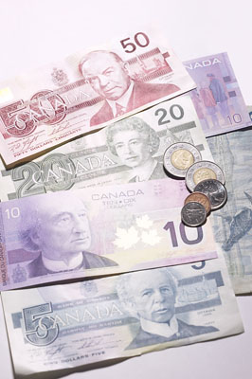
Types of Taxes
In Canada, the federal, provincial, and local government levels ALL collect taxes from citizens in a variety of different forms.
Federal Taxes: GST, income tax
Provincial Taxes: Alberta tax
Local Taxes: property tax

Slide 5
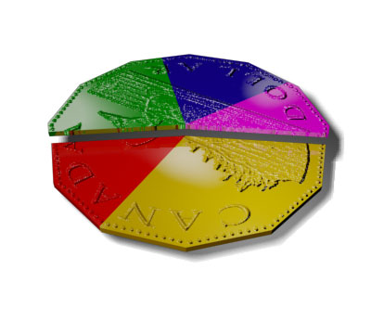
Transfer Payments
In Canada, the federal government transfer some of the taxes it receives from Canadians to the provinces of Canada, based on their level of need.
In Canada, these transfers include the Canada Health Transfer and the Canada Social Transfer. These funds go towards social programs.

Slide 6
Death to Taxes
Every country and political party has different ideas on what types of taxes to collect, as well as how to spend those tax dollars within their country.
The money a country has to spend
from taxes is called a tax base.
In all countries, it’s against the law
to NOT pay taxes. If you don’t, you
can go to jail for tax evasion.

Slide 7
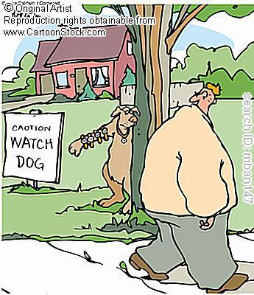
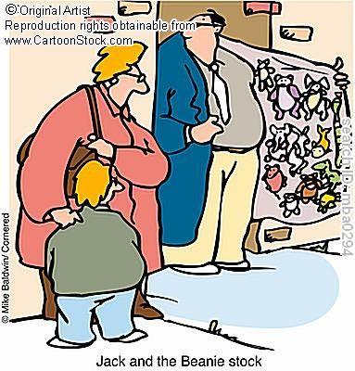
Other Illegals

Slide 8
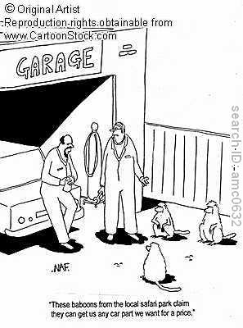
The Underground Economy
People who do not pay the taxes required by law are considered to be part of the ‘underground’ economy.
Why is it called ‘underground’?
Another term for the underground economy is the black market.

Slide 9
What effect do tax evaders have?
How does tax evasion affect law-abiding Canadians?
If Canadians fail to pay taxes as required, less money is available to governments to support social programs as well as to assist other programs.
How is the quality of life of Canadians affected?

