Slide 1
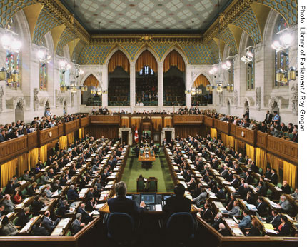
THE HOUSE OF COMMONS (Part of Legislative Branch)
Quick facts!

Slide 2
Facts of House of Commons
• made up of 308 elected Members of Parliament;
• is the principal law-making body in Canada;
• members devote most of their time to debating and voting on bills.

Slide 3
House of Commons
• members devote most of their time to debating and voting on bills.
They also:
– represent constituents’ views;
– discuss national issues;
– call on the government to explain its actions.
the House of Commons meets for about 130 days a year.

Slide 4
Daily Proceedings
Daily events include:
Members’ Statements—a 15-minute period is set aside each day for any Member who is not a Cabinet Minister to make a statement on a subject of national, regional or local importance. Each statement lasts a maximum of one minute.
Question Period—a 45 minute session where opposition Members, and sometimes government Members ask questions of the Prime Minister and Cabinet Ministers. It is an exercise in accountability: Members can ask Ministers any question about their area of responsibility, without giving advance notice.

Slide 5
Daily Proceedings
Routine Proceedings—these can cover the tabling of committee reports, announcements about government policy, petitions, introduction of bills for first reading.
Private Members’ Business—for one hour each day
Members who are not Cabinet Ministers can have their bills and motions debated by the House.

Slide 6
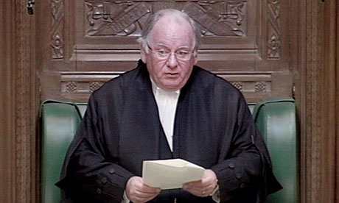
The Speaker
The House of Commons elects a presiding officer, known as the Speaker, at the beginning of each new parliamentary term, and also whenever a vacancy arises.
The Speaker (assisted by deputy speakers), presides over the House.
He or she is almost always present during question period and major debates.

Slide 7
House of Commons
The government introduces its policy/strategy for the year in the Throne Speech at the opening session of parliament;
The government’s annual budget, introduced by the Minister of Finance, sets out government monetary and fiscal policies for the year, what it plans to spend and what its expected revenue will be.

