Slide 1
Significant Responsibilities
Social Studies 9

Slide 2
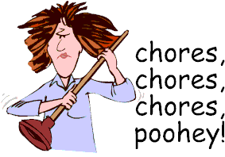
What are you responsibilities?
We all have responsibilities that we have to fulfill in our daily lives.
What are the responsibilities that you have to complete?

Slide 3
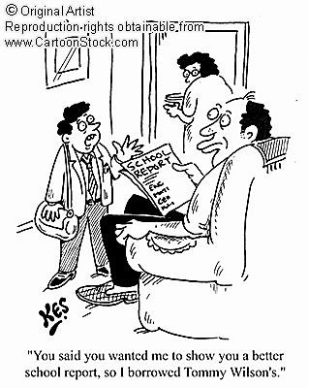
What happens when you do not fulfill your responsibilities?
Important things don’t get done (for you, your family, your community)
Failing marks
Punishments
People could get hurt
People get angry with you

Slide 4
What are your three most significant responsibilities?
Take a moment with a group of your classmates and decide on what your three most important responsibilities as an adolescent are.
Now, describe WHY those are the three most significant responsibilities you have.

Slide 5
Criteria for Significant Responsibilities
A significant responsibility means:
Reliance; you are relied upon
Consequences; if unfulfilled, there are negative effects on others.
Benefits: it helps you and others.

