Slide 1
Government Intervention in a Market Economy

Slide 2
Government Intervention
In a market economy, individuals (businesses, corporations, etc) , along with the forces of supply and demand, answer the basic problem of scarcity.
However, there are many cases in free market economies where the government has chosen to become involved in the economy.
Discuss the following slides and why or why not the government should take action for each issue.

Slide 3
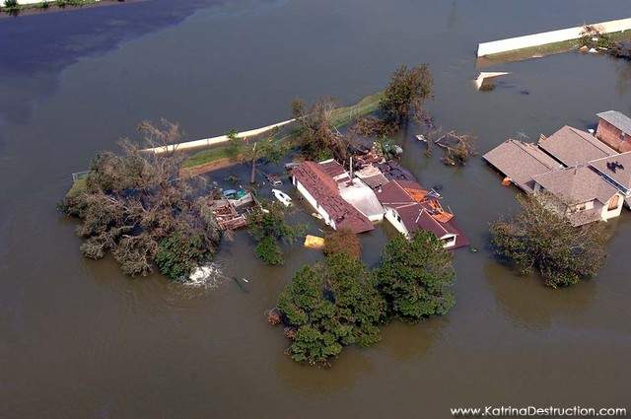
Environmental Disasters
Hurricane Katrina
The government of the United States donated money & resources to help the citizens of Louisiana escape, then rebuild.

Slide 4
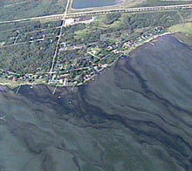
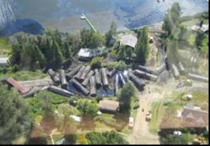
Environmental Protection
CN Rail derailment and oil spill, Lake Wabamun, 2005
The Canadian government became involved to ensure CN Rail cleaned up the spill, and tested water and soil quality to ensure the safety of nearby human residents, plants, and animals.

Slide 5
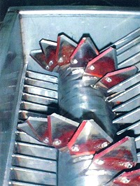
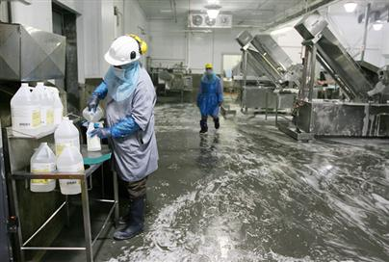
Food Safety
In the fall of 2008, Maple Leaf Foods recalled over 200 products from grocery store shelves to prevent a further outbreak of listeria, a food borne illness later found in the slicing equipment of a Toronto processing plant.
The Canadian government is involved in food safety standards, regulations, and testing of all food processing facilities.

Slide 6
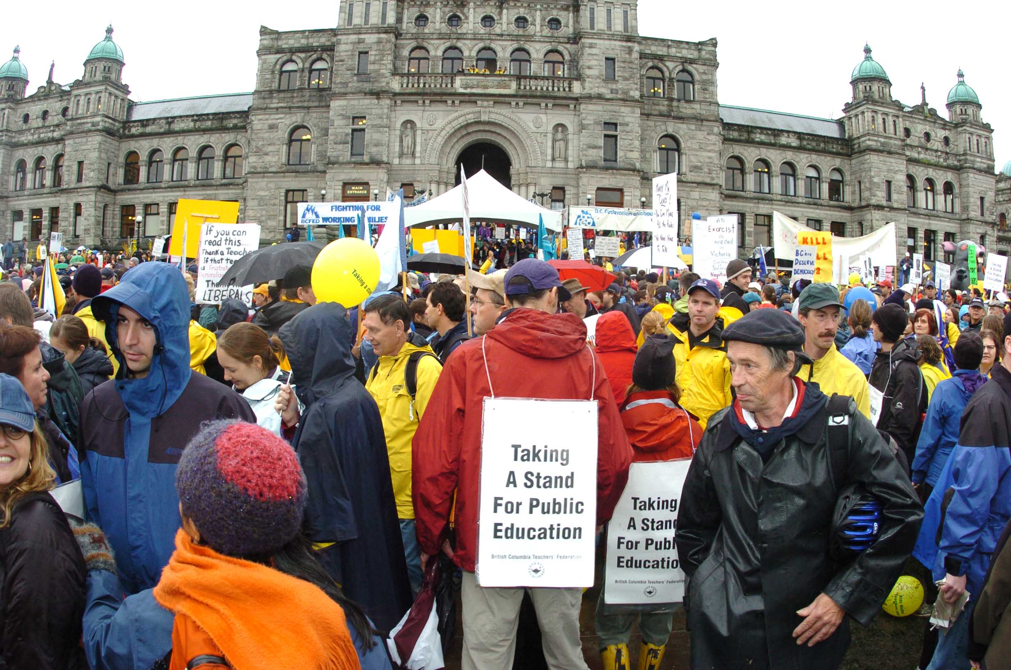
Labour Disputes
In 2002, teachers in Alberta went on strike to demand better classroom conditions.
After a month, the Alberta government intervened, passing a law to force teachers back to work.
Many people are prevented from striking by law because of their status as an “essential service”, such as doctors, paramedics, and now, teachers.

Slide 7
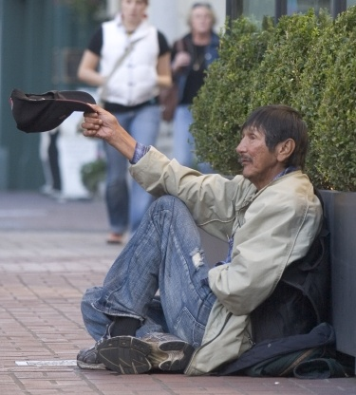
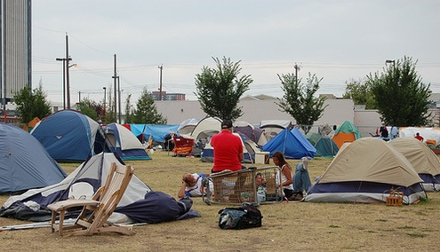
Homelessness
In the summer of 2007, homelessness in the city of Edmonton reached an estimated almost 2000 people. Many homeless formed a ‘tent city’ to protest the lack of affordable housing.
The government intervened, closing down tent city. The city of Edmonton has provided additional funding to help build/convert housing to be more affordable.

Slide 8
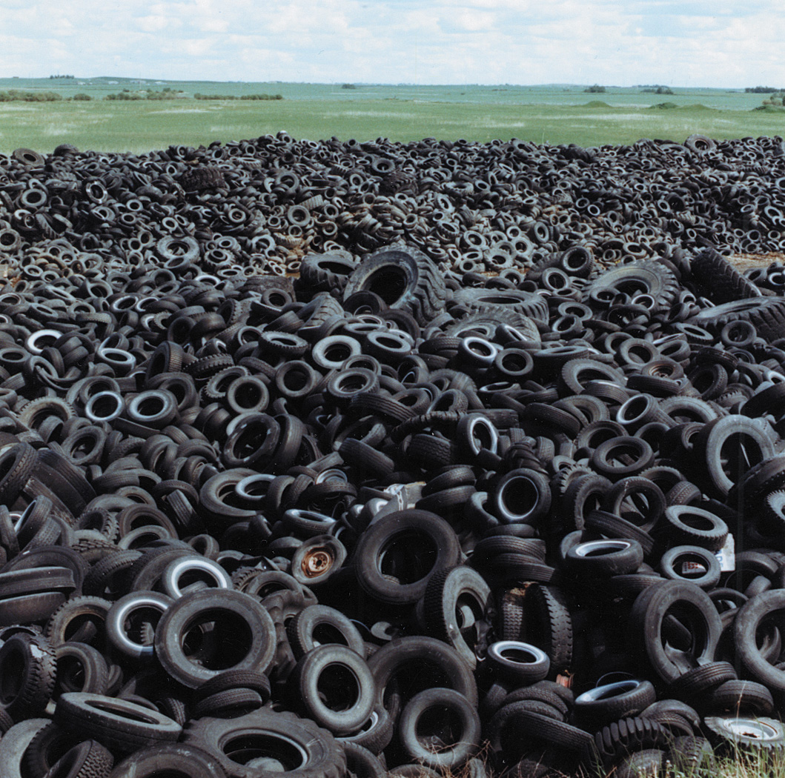
ENVIRONMENT TAX ACT
(2) Subject to subsection (3), every purchaser of a new tire for a motor vehicle shall pay to her Majesty in right of the province a tire tax at the
rate of $4 for each tire purchased.
The government has passed a law that states that anyone purchasing a new tire must pay this tax.
What is the purpose of this tax?

Slide 9
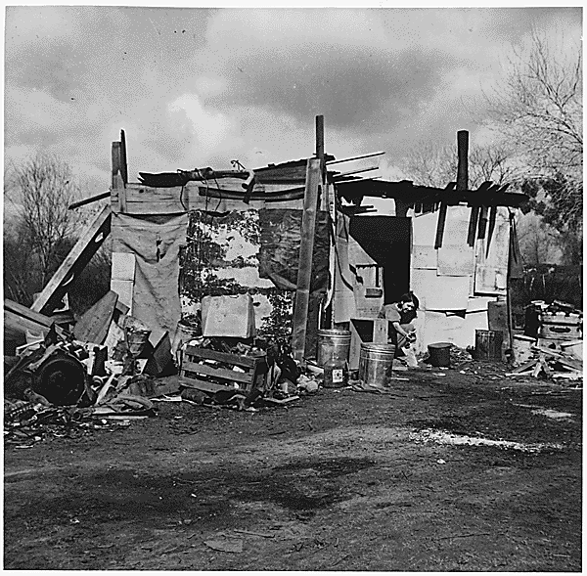
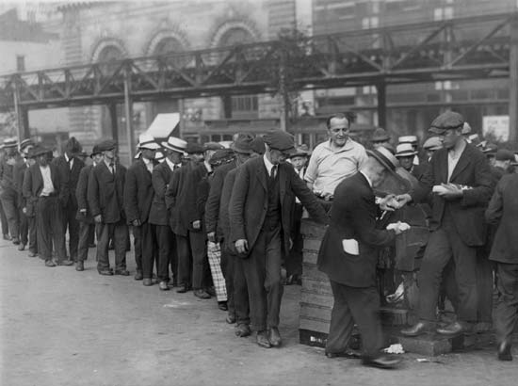
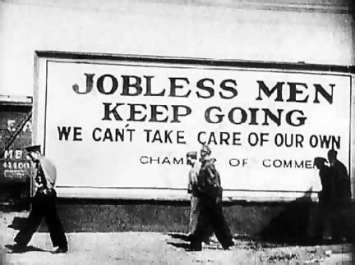
The Great Depression
In the 1930’s, the world experienced the largest economic downturn in the history of the modern era. It is estimated that over 15 million Americans became unemployed.
USA president Franklin D. Roosevelt, intervened and offered new government ideas, such as pensions for seniors, farmer support funds, and government-owned work projects. (Hoover Dam was built then!)

Slide 10
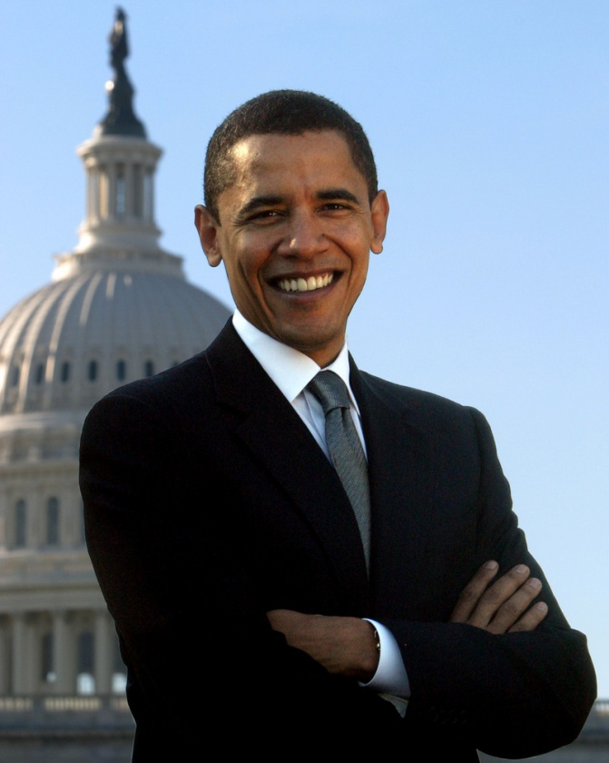
Stimulus Bill
In light of the recent depression, one of Barack Obama’s first moves as President of the United States was to introduce a “stimulus bill”, to help the American economy.
The stimulus bill invests 500 billion in new work projects and encourages Americans to spend money to support their country.

