Slide 1
How are Canada's immigration laws today different than in the past?
Notes:
Text pg. 173
A work in progress – will send an update ASAP. Cheers - Sophia

Slide 2
Current Practices
No one today is excluded from Canada because of their race or country of origin.
The point system, for example, evaluates people based on their skills and education.

Slide 3
Past Practices
Canada favoured immigrants of British ancestry and restricted immigration from Asian countries such as China and India.
Why?
http://www3.nfb.ca/duneculturealautre/theme_vis.php?id=1994&mediaid=662368
http://www3.nfb.ca/duneculturealautre/theme_vis.php?id=2002&mediaid=662376

Slide 4
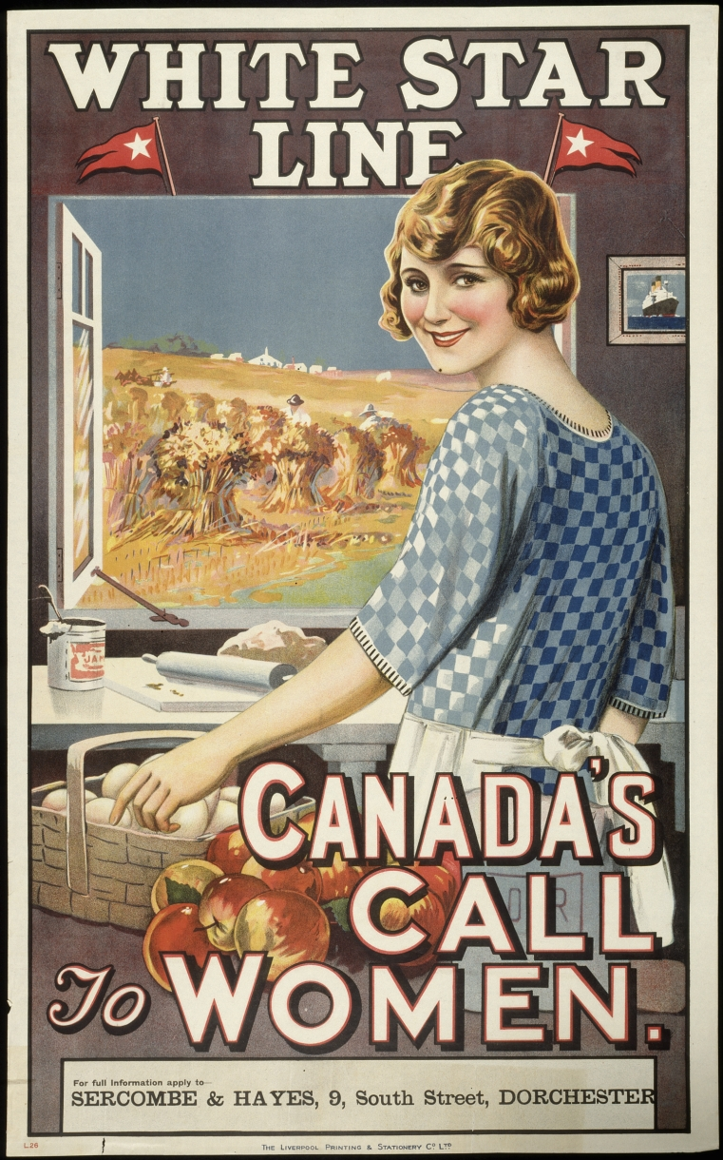
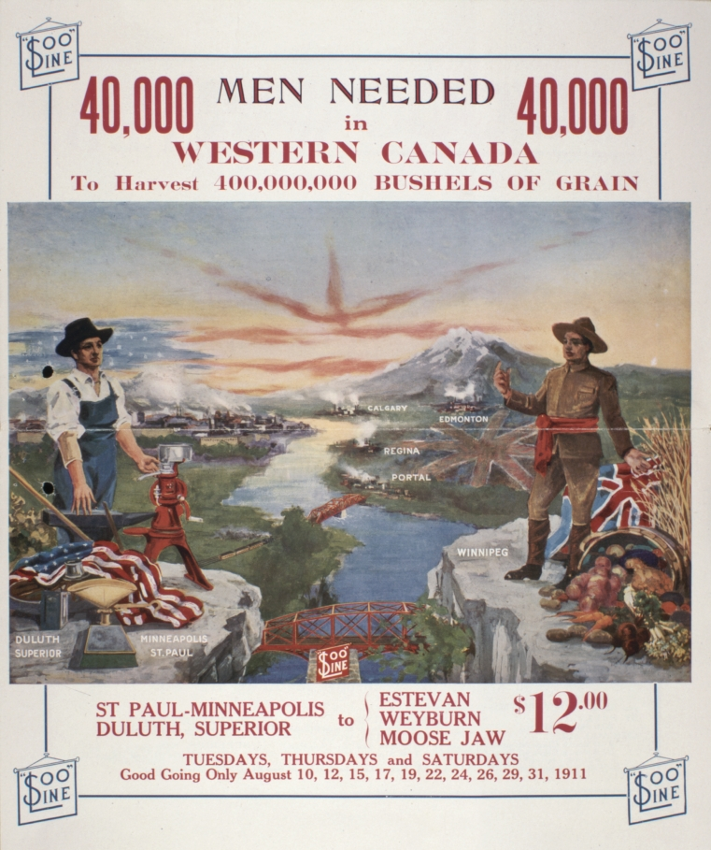
Recruitment Posters

Slide 5
History of Immigration in Canada
http://www.youtube.com/watch?v=Yo4ViKqT7Cw
http://www.youtube.com/watch?v=YausHoTooPQ&NR=1
http://www.youtube.com/watch?v=PJx3FZriQxI&feature=related

Slide 6
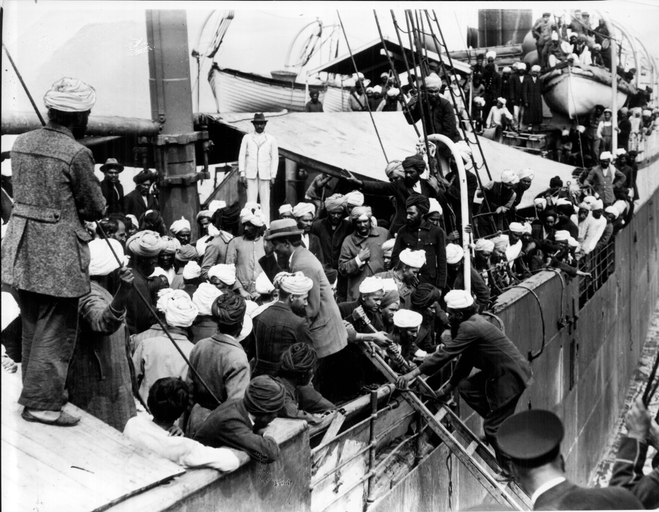
Komagata Maru

Slide 7
“Continuous Voyage Order”
Required prospective immigrants to travel in an uninterrupted journey, and since no such voyage existed from South Asia, creating a requirement for immigration that would be impossible for Sikhs to meet.
In 1914, however, 376 Sikhs, led by Bhai Gurdit Singh, challenged this order by making the trip on the vessel, Komagata Maru.
Arriving in Vancouver on May 23, 1914, they were refused entry and kept anchored in Vancouver harbor for two months.
On July 23, 1914, they were escorted out of Canadian waters by naval guard, sent on the long journey back to South Asia.
http://www3.nfb.ca/duneculturealautre/theme_vis.php?id=1994&mediaid=662319
Notes:
www.wingluke.org/.../lifeinthepnw.html

Slide 8
Head-Tax
Between 1885-1923, Canada discouraged immigration from China by requiring every Chinese immigrant to pay a fixed fee, known as a head tax.
http://archives.cbc.ca/society/immigration/clips/9242/
http://archives.cbc.ca/society/immigration/clips/9243/

Slide 10
Why do you think Canada's immigration policies have changed over time?
Notes:
Complete on smartboard

Slide 11
How do you think immigration policies may change in the future?

